Slide 1

BANKING APPLICATION
TECHONOLOGIES USED
Language : Python
Database : MYSQL
Environment : Jupyter Notebook
Modules Used : Date Time, MYSQL Connector
Git Hub : https://github.com/Poonam-Patil-29/Banking-Application-Python-Project
Poonam Patil
MSc (Comp. Science)

Slide 2
INTRODUCTION
This project is designed for The Bank Staff's to keep the records of their customers. Only authorized Users can have the accessibility to the program. Data entered by the user are stored in MYSQL database in tabular form. The Best Part of this code is that it is 100 % user friendly because of excess use of exceptional handling. User after Logging in have the support to display all records, and modify it accordingly.
Banking Application is used to perform various banking transactions like user can withdraw the amount, user can deposit the money, user can able to view the transaction history, user can able to view his profile, user can update the account details and user can delete account.

Slide 3
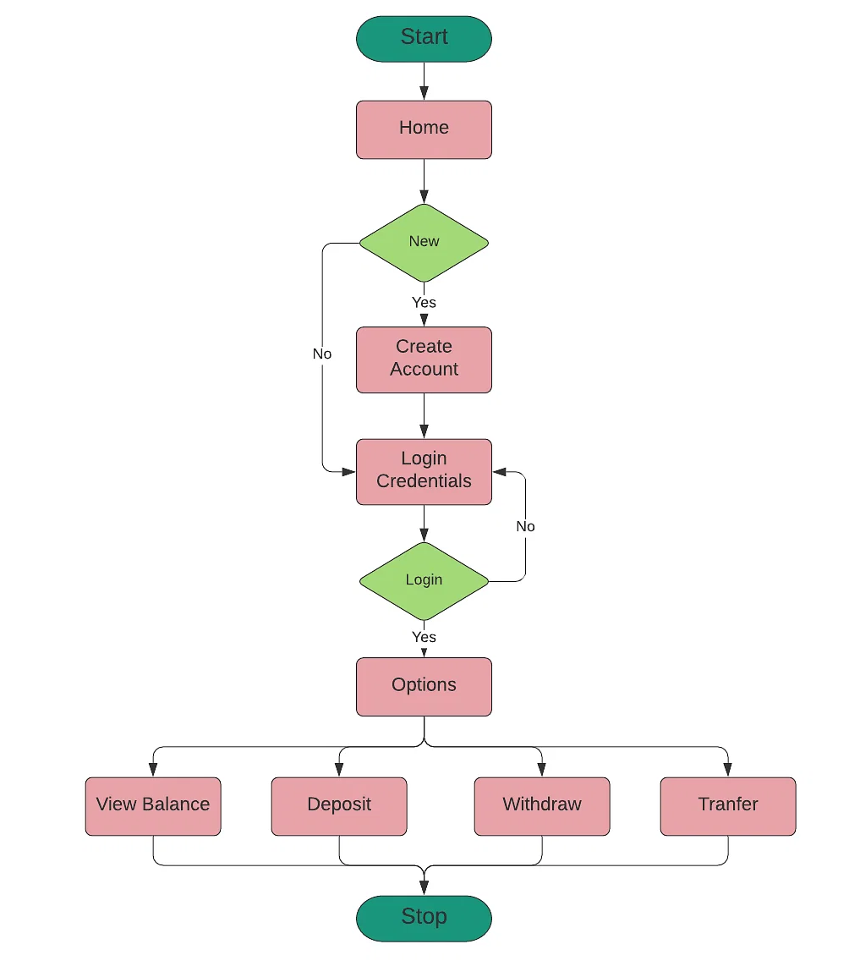
DATA FLOW DIAGRAM

Slide 4
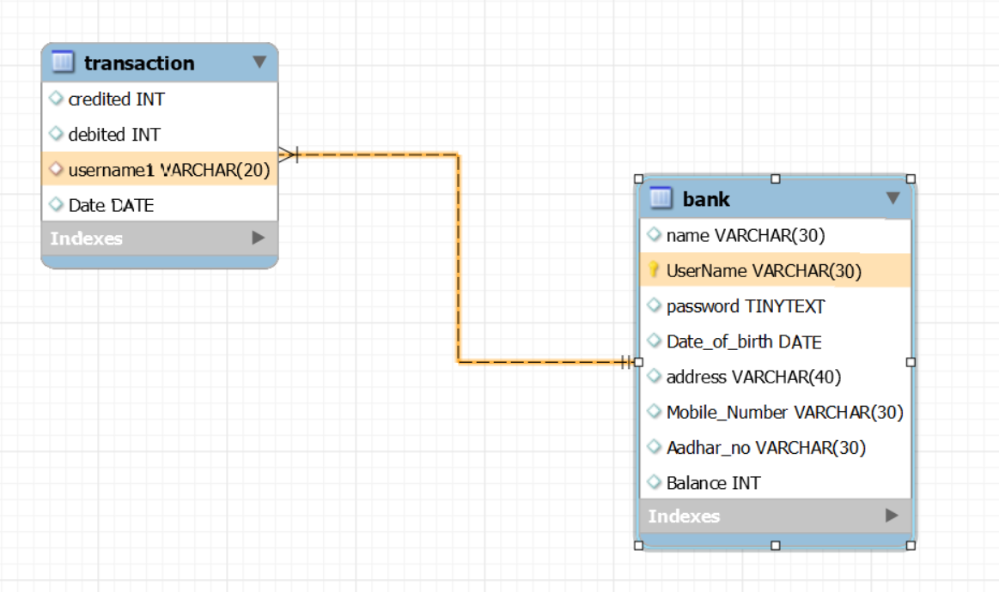
ENTITY RELATIONSHIP DIAGRAM
BANKING APPLICATION

Slide 5
Thank You
@ Mariya Padiyapuram
@ Sandarya Paul

